Slide 1
Creating GUIs in Java using Swing
Medialogy, Semester 4, 2009
Aalborg University, Aalborg
http://moodle.vrml.aau.dk/course/view.php?id=59
David Meredith dave@imi.aau.dk

Slide 2
Resources
The Sun Java Tutorial on “Creating a GUI with JFC/Swing”, available here:
  http://java.sun.com/docs/books/tutorial/uiswing/index.html

Slide 3
Java Foundation Classes (JFC)
JFC is a group of Java packages for
  building GUIs
  adding rich graphics
  adding interactivity
JFC defined to provide the following features:
  Swing GUI Components
    From buttons to split panes and tables
    Components capable of sorting, printing, drag-and-drop, etc.
  Pluggable look-and-feel Support
    So the same program can use different look-and-feels (e.g., Java look, Windows look, GTK+ and many more)
  Accessibility API
    Enables assistive technologies like screen readers and Braille displays to get information from the UI
  Internationalization
    Allows developers to build applications that interact with users using many different languages and alphabets

Slide 4
Swing packages
Swing API has 18 packages:
  javax.swing
  javax.swing.event
  javax.swing.plaf
  javax.swing.text
  ...
Most of the time we use only two:
  javax.swing
  javax.swing.event

Slide 5
Concurrency in Swing
In Swing, you use three different kinds of thread
  Initial threads
    In a normal application, there will be only one initial thread: the main thread
  Event dispatch thread
    Most code that interacts with the Swing framework executes on this thread
  Worker threads
    “Background” threads on which time-consuming tasks are executed
You don’t need to create these threads explicitly
  They are provided by the runtime or the Swing framework

Slide 6
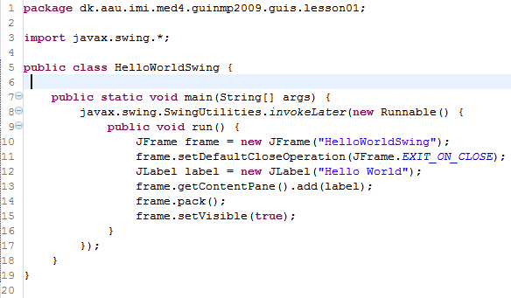
Initial threads
In Swing, initial thread (main thread) usually just creates a Runnable object (the GUI) which is passed to the event dispatch thread to be executed
Once the GUI is running, GUI events cause short tasks to be carried out on the event dispatch thread
Longer tasks should be scheduled for execution on Worker threads

Slide 7
invokeLater
Main thread schedules the GUI creation task by invoking javax.swing.SwingUtilities.invokeLater
  This takes a single Runnable object as its argument and schedules it to be executed on the event dispatch thread
Main thread does not create and run the GUI itself because almost all code that interacts with Swing must run on the event dispatch thread

Slide 8
The event dispatch thread
Event handling code is code that is executed when some GUI event occurs (e.g., the user clicks a button or moves a slider)
All event handling code in Swing must run on the event dispatch thread
Most code that calls Swing methods should also run on the event dispatch thread
  This is because most Swing object methods are not thread safe
    Invoking these methods from different threads can lead to interference
Think of the code running on the event dispatch thread as a series of short tasks, most of which are carried out in response to GUI events
If longer events are run on the event dispatch thread, unhandled GUI events build up and the interface becomes unresponsive

Slide 9
HelloWorld in Swing
Use invokeLater to create a Runnable to be executed on the event dispatch thread
The run method starts by creating a JFrame object which is the main window of the application (l.10)
Set the default close operation to be “EXIT_ON_CLOSE” which means the app exits when the close button is pressed (l.11)
Create a label object containing the “Hello World” message (l.12)
We get the content pane for the JFrame object and put the label in it (l.13)
  The content pane contains all the Swing components for a JFrame
We invoke the “pack” method on the JFrame to set the size of the window so that it is just big enough to hold all the components in the content pane (l.14)
We make the JFrame visible (l.15)

Slide 10
HelloWorldSwing.java

Slide 11
A visual index to the Swing components
http://java.sun.com/docs/books/tutorial/ui/features/components.html

Slide 12
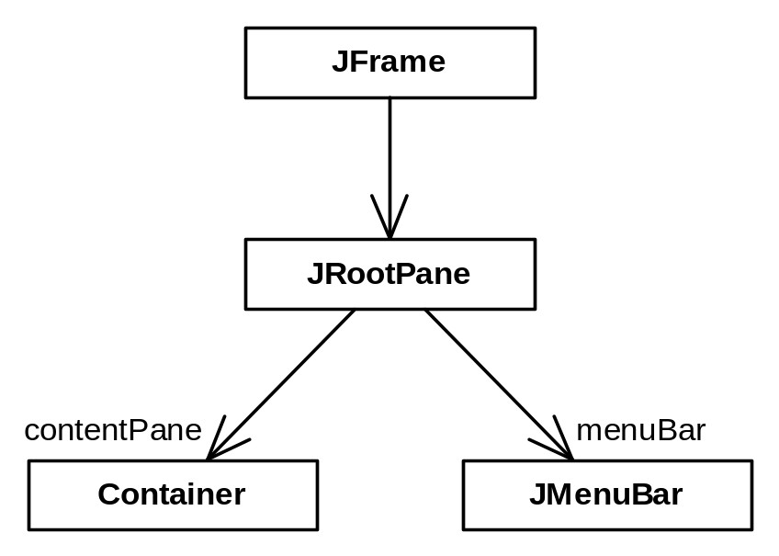
JFrame
The main window of the application is a JFrame object
A JFrame contains a JRootPane object
The JRootPane object contains
  a Container object called contentPane and
  a JMenuBar object called menuBar
All the components in a window (e.g., buttons, text fields, labels, sliders) must be contained in the JFrame’s contentPane
The window’s menubar is stored separately in the menuBar object
The menuBar field of a JFrame can be null
  menu bars are optional
The contentPane field of a JFrame cannot be null
  throws an exception

Slide 13
Accessing the content pane of a JFrame
To retrieve the content pane of a JFrame:
  frame.getContentPane();
To add a component to the content pane:
  frame.getContentPane().add(yellowLabel);
To remove a component from the content pane:
  frame.getContentPane().remove(yellowLabel);

Slide 14
ContentPanes.java

Slide 15
Layout managers
A layout manager is an object that implements the LayoutManager interface
Determines size and position of components within a container
Each component can request to have a certain size and alignment
  But layout manager has final say
The only containers with layout managers that you need to worry about are content panes and JPanels
  A JPanel is simply a rectangular region within a window’s content pane into which you can put Swing components, just as you would put them into a content pane
  It’s a region of the window where you can control layout independently from the rest of the window

Slide 16
A Visual Guide to Layout Managers
http://java.sun.com/docs/books/tutorial/uiswing/layout/visual.html

Slide 17
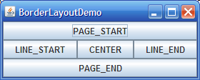
BorderLayout
See BorderLayoutDemo.java
Add components using
  pane.add(new JLabel(“Hello”), BorderLayout.PAGE_START
Gaps between areas can be specified using
  layout.setVgap() and layout.setHgap()
Can leave regions empty
If try adding second component to a region, it replaces the first
Center region expands to fill space available
By default, components added to center region
  i.e. as if with BorderLayout.CENTER

Slide 18
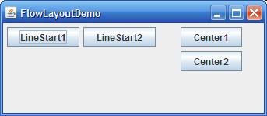
JPanels and FlowLayout
See FlowLayoutDemo.java
JPanel is a container that can be used inside another container such as a content pane
JPanel uses FlowLayout layout manager
Put a JPanel in one area of BorderLayout so that you can put more than one component into that area (by putting the components in the JPanel)
FlowLayout puts components in a row
If container is not wide enough, FlowLayout starts a new row
If container is more than wide enough, components are centered
  Can change alignment using FlowLayout.setAlignment()
Change the padding using setHgap() and setVgap()

Slide 19
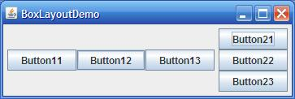
BoxLayout
See BoxLayoutDemo.java
BoxLayout stacks components on top of each other or places them in a row
  To get them in a row, use
    panel1.setLayout(new BoxLayout(panel1, BoxLayout.X_AXIS))
  To get them in a column, use
  panel1.setLayout(new BoxLayout(panel1, BoxLayout.Y_AXIS))
Like FlowLayout but with greater functionality

Slide 20
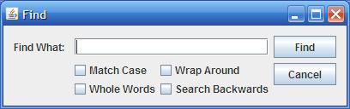
GroupLayout
GroupLayout developed for GUI builders like the one in NetBeans
But also works for manual coding of GUIs
Works with horizontal and vertical layouts separately
  Can forget about horizontal layout when defining vertical and vice-versa
  But need to define each component twice in the layout
  If forget to define a component twice, GroupLayout generates an exception

Slide 21
Layout Organization: Hierarchical Groups
GroupLayout uses two different types of groups, arranged into a hierarchy
  Sequential groups
    Components placed one after the other as in BoxLayout or FlowLayout
  Parallel groups
    Next to each other in the same dimension
Parallel group usually an element in a sequential group in the other dimension
A group may contain components or other groups

Slide 22

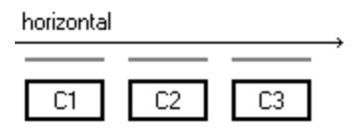
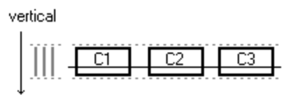
An example of GroupLayout
Layout three components in a row
Sequential horizontal group of 3 components
Parallel vertical group of the same 3 components with same (vertical) location, size and baseline
In pseudo-code:
horizontal_layout = sequential_group { c1, c2, c3 }
vertical_layout = parallel_group (BASELINE) { c1, c2, c3 }

Slide 23
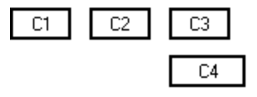
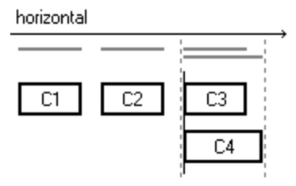
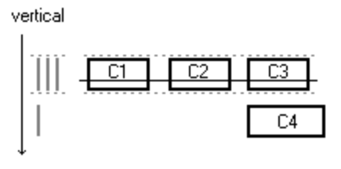
Another example of GroupLayout
C4 is left-aligned with C3
  C4 and C3 have the same horizontal position
  C4 and C3 form a parallel horizontal group
Vertically, there is a sequential group consisting of the parallel group, {C1,C2,C3} followed by C4
In pseudo-code:
horizontal_layout = sequential_group { c1, c2, parallel_group (LEFT) { c3, c4 } } vertical_layout = sequential_group { parallel_group (BASELINE) { c1, c2, c3 }, c4 }

Slide 24
Gaps in GroupLayout
Gap is an invisible component that controls distance between other components
GroupLayout defines automatic gaps
  Give preferred distances between neighbouring components and between components and container borders
  Size computed based on look-and-feel
Need to turn on automatic gaps using
  layout.setAutoCreateGaps(true);
  layout.setAutoCreateContainerGaps(true);

Slide 25
Writing code in GroupLayout
See GroupLayoutDemo.java

